Slide 1
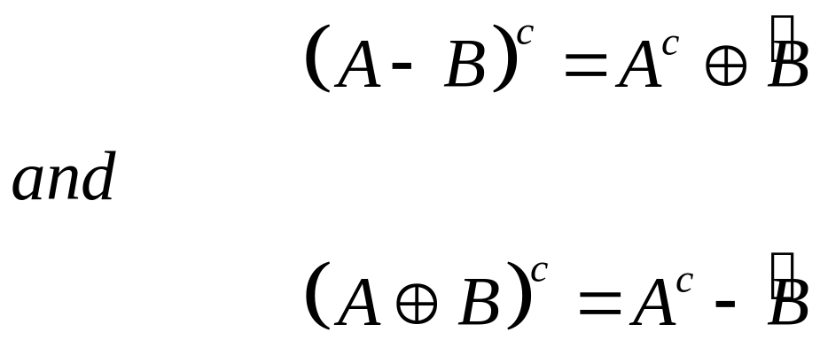
Duality
Erosion and dilation are duals of each other with respect to set complementation and reflection
1

Slide 2
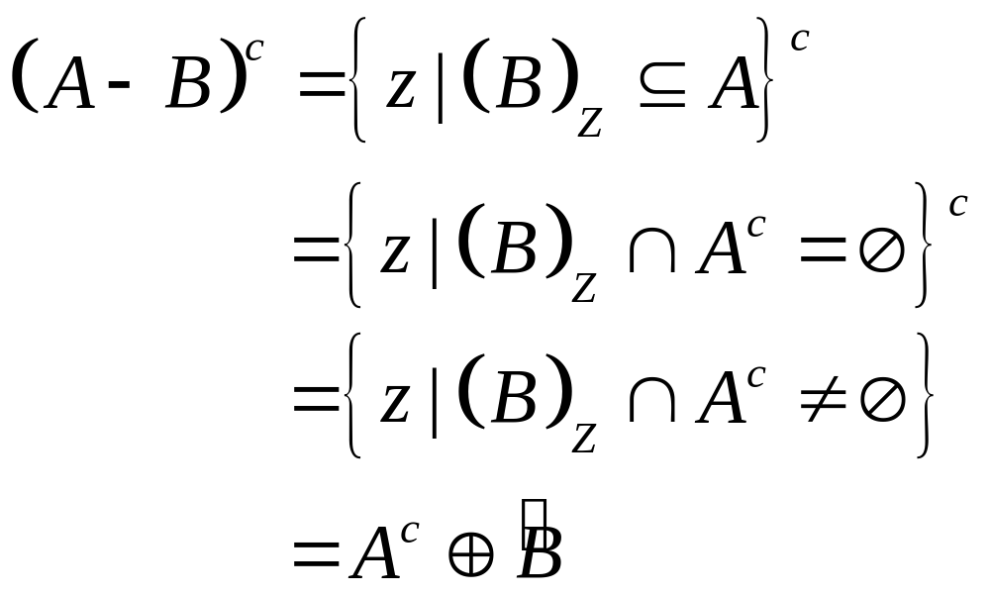
Duality
Erosion and dilation are duals of each other with respect to set complementation and reflection

Slide 3
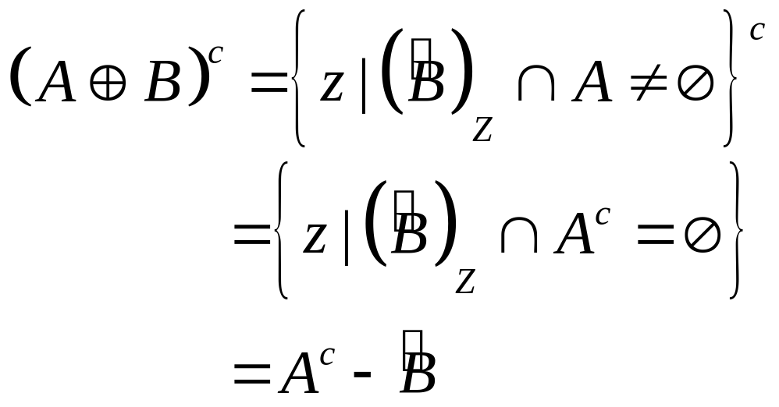
Duality
Erosion and dilation are duals of each other with respect to set complementation and reflection

Slide 4
Opening and Closing
Opening generally smoothes the contour of an object, breaks narrow isthmuses, and eliminates thin protrusions
Closing tends to smooth sections of contours but it generates fuses narrow breaks and long thin gulfs, eliminates small holes, and fills gaps in the contour

Slide 5
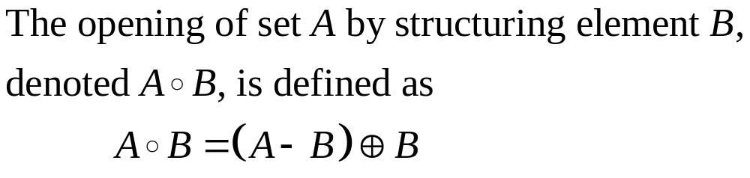
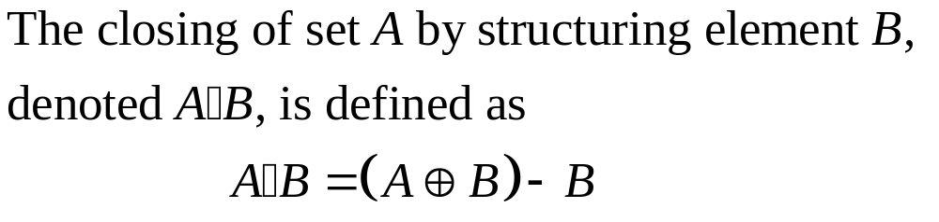
Opening and Closing

Slide 6
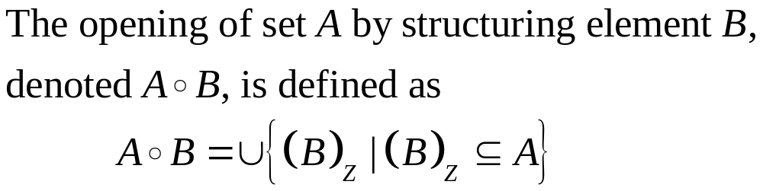
Opening

Slide 7
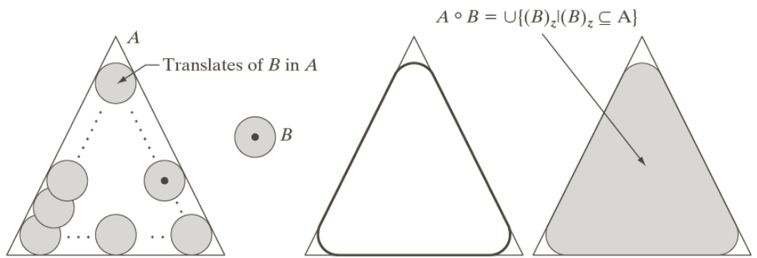
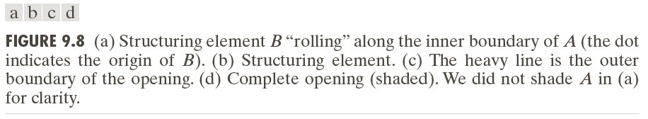
Example: Opening

Slide 8
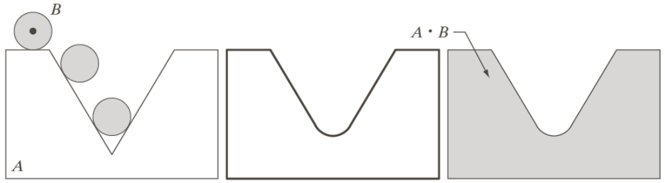
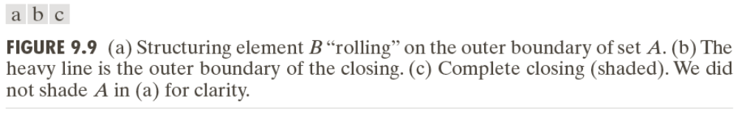
Example: Closing

Slide 10

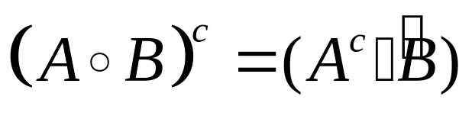
Duality of Opening and Closing
Opening and closing are duals of each other with respect to set complementation and reflection

Slide 11
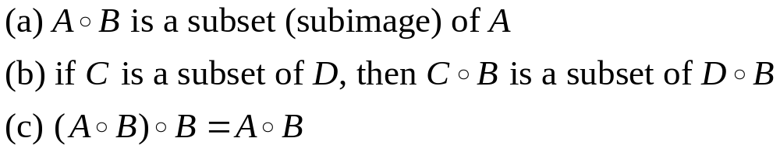
The Properties of Opening and Closing
Properties of Opening
Properties of Closing

Slide 12
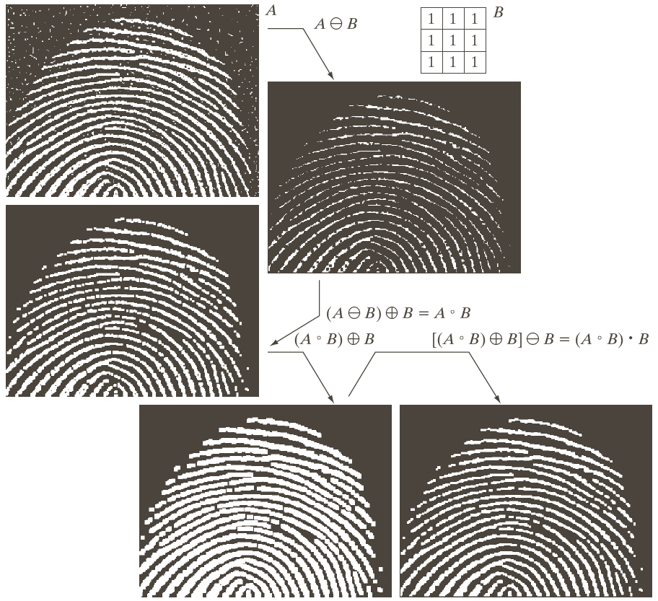
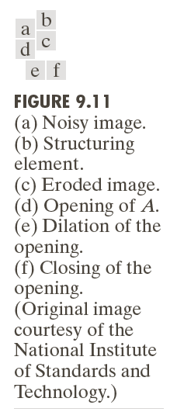

Slide 13
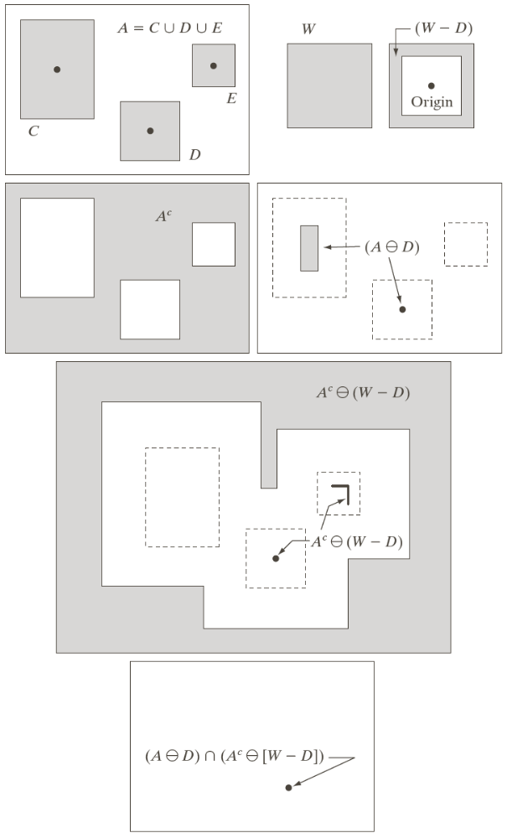
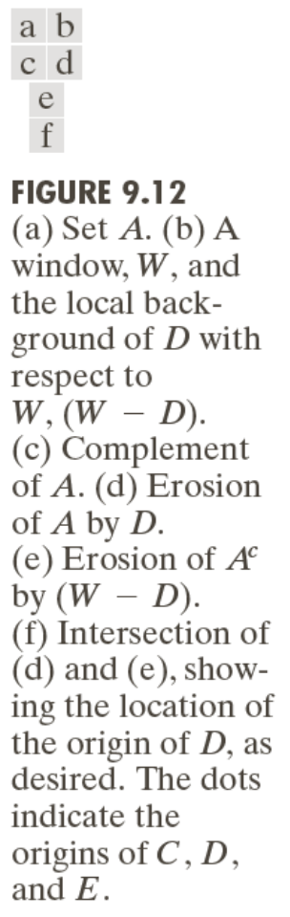
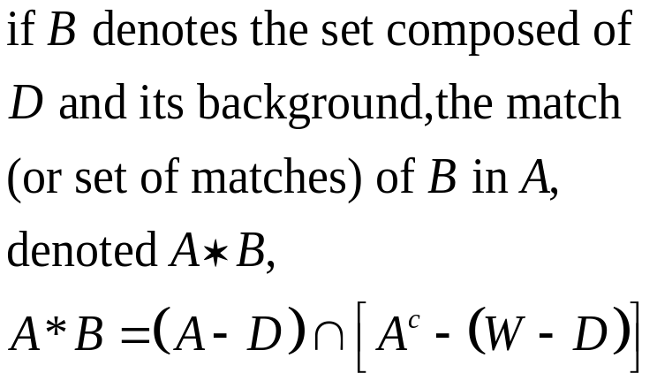
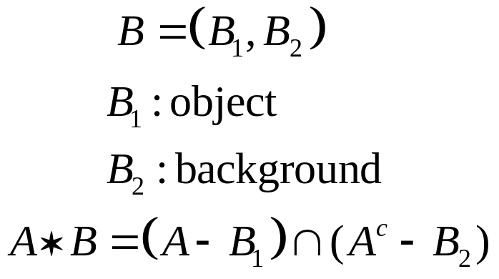
The Hit-or-Miss Transformation

Slide 14
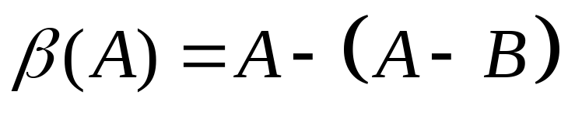
Some Basic Morphological Algorithms (1)
Boundary Extraction
The boundary of a set A, can be obtained by first eroding A by B and then performing the set difference between A and its erosion.

Slide 15
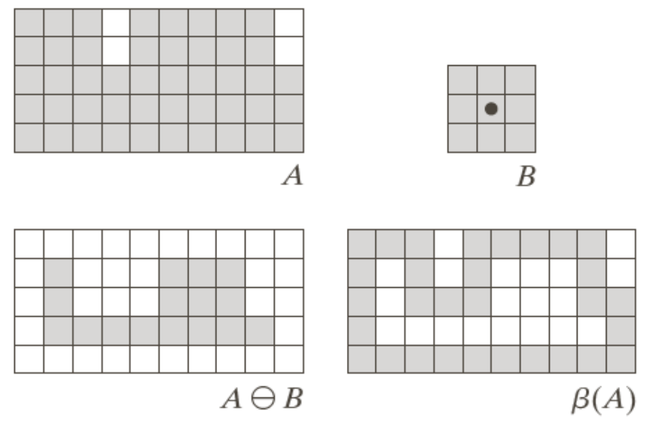
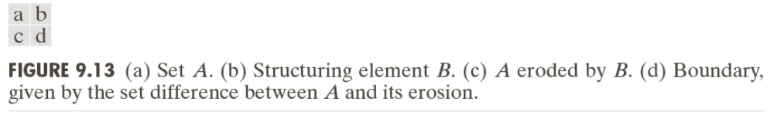
Example 1

Slide 16

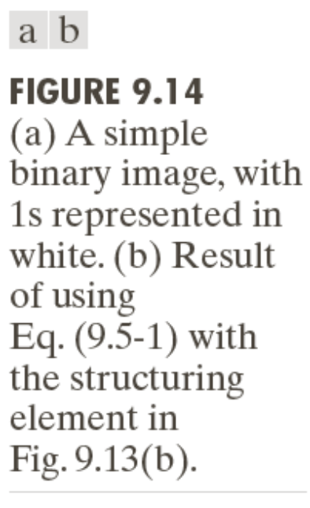
Example 2

Slide 17
Some Basic Morphological Algorithms (2)
Hole Filling
A hole may be defined as a background region surrounded by a connected border of foreground pixels.
Let A denote a set whose elements are 8-connected boundaries, each boundary enclosing a background region (i.e., a hole). Given a point in each hole, the objective is to fill all the holes with 1s.

Slide 18

Some Basic Morphological Algorithms (2)
Hole Filling
1. Forming an array X₀ of 0s (the same size as the array containing A), except the locations in X₀ corresponding to the given point in each hole, which we set to 1.
2. X_{k} = (X_{k-1} + B) A^{c} k=1,2,3,…
Stop the iteration if X_{k} = X_{k-1}

Slide 19
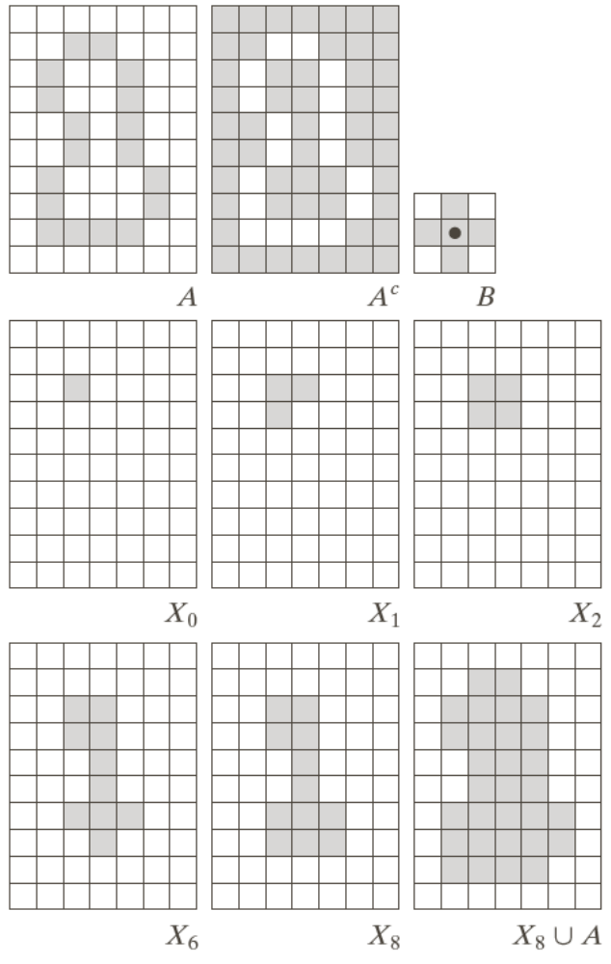
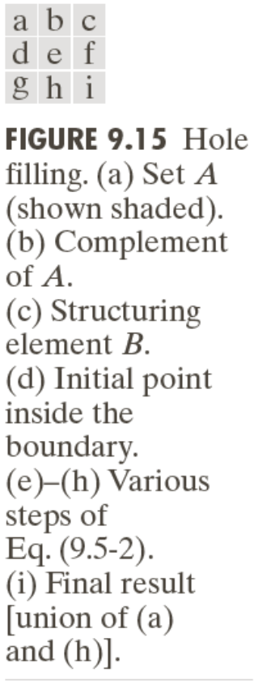
Example

Slide 20

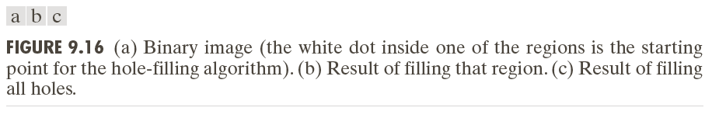

Slide 21
Some Basic Morphological Algorithms (3)
Extraction of Connected Components
Central to many automated image analysis applications.
Let A be a set containing one or more connected components, and form an array X₀ (of the same size as the array containing A) whose elements are 0s, except at each location known to correspond to a point in each connected component in A, which is set to 1.

Slide 22
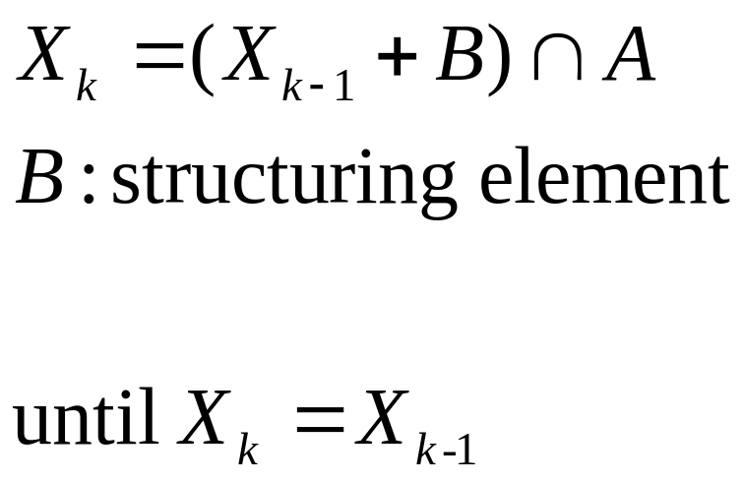
Some Basic Morphological Algorithms (3)
Extraction of Connected Components
Central to many automated image analysis applications.

Slide 23
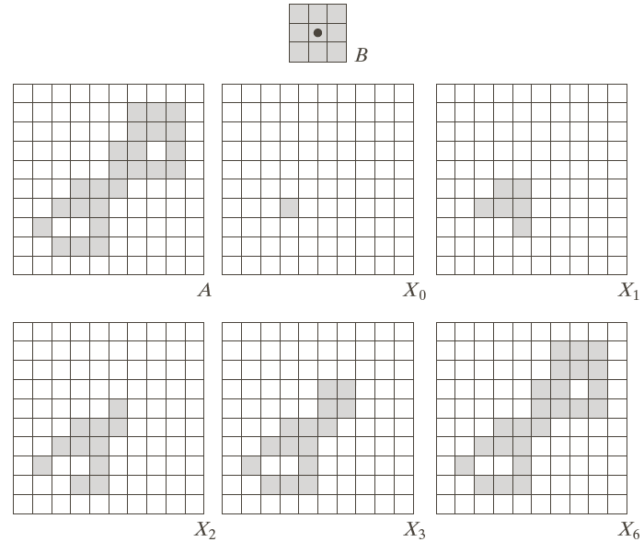
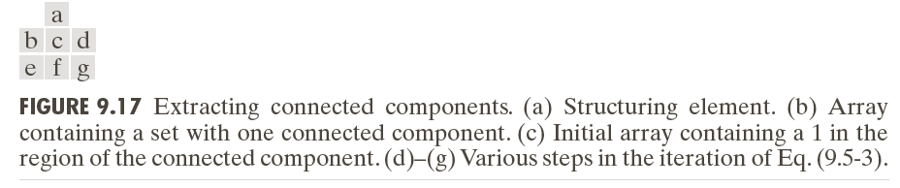

Slide 24
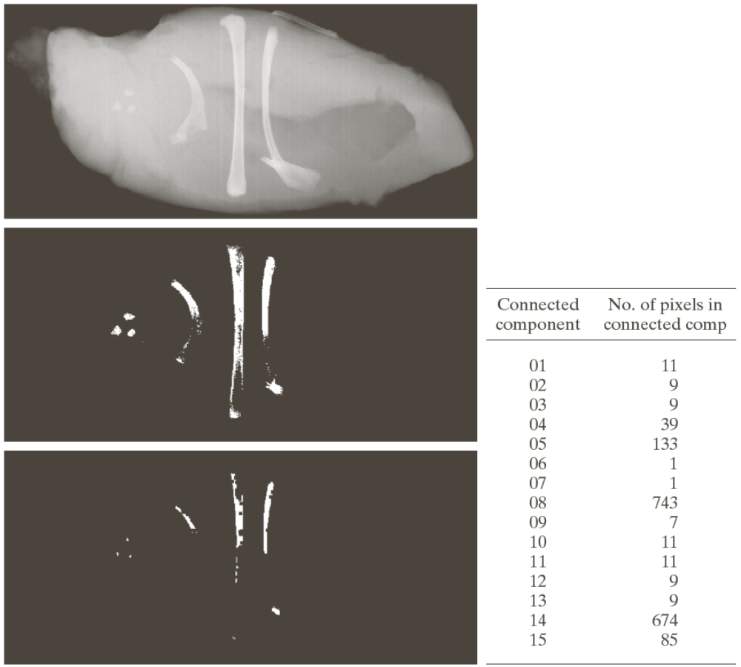
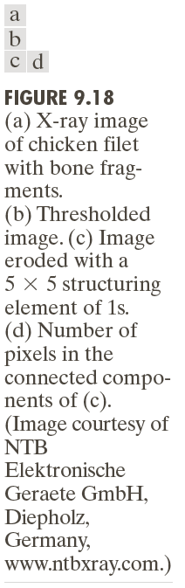

Slide 25
Some Basic Morphological Algorithms (4)
Convex Hull
A set A is said to be convex if the straight line segment joining any two points in A lies entirely within A.
The convex hull H or of an arbitrary set S is the smallest convex set containing S.

Slide 26
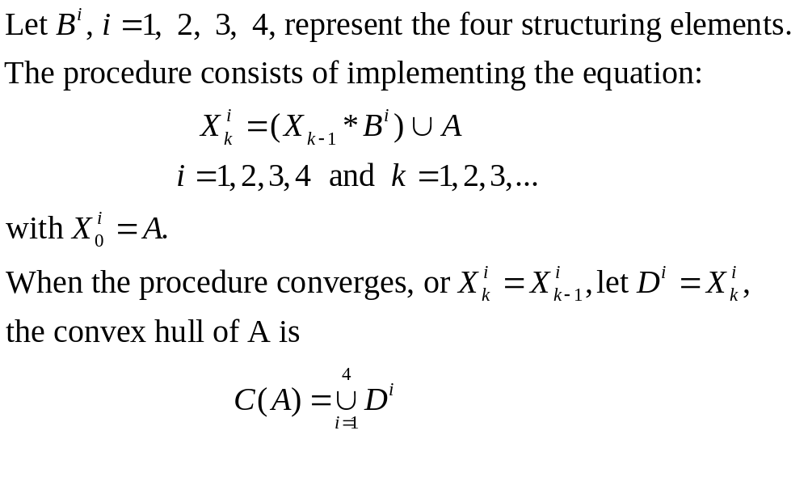
Some Basic Morphological Algorithms (4)
Convex Hull

Slide 27
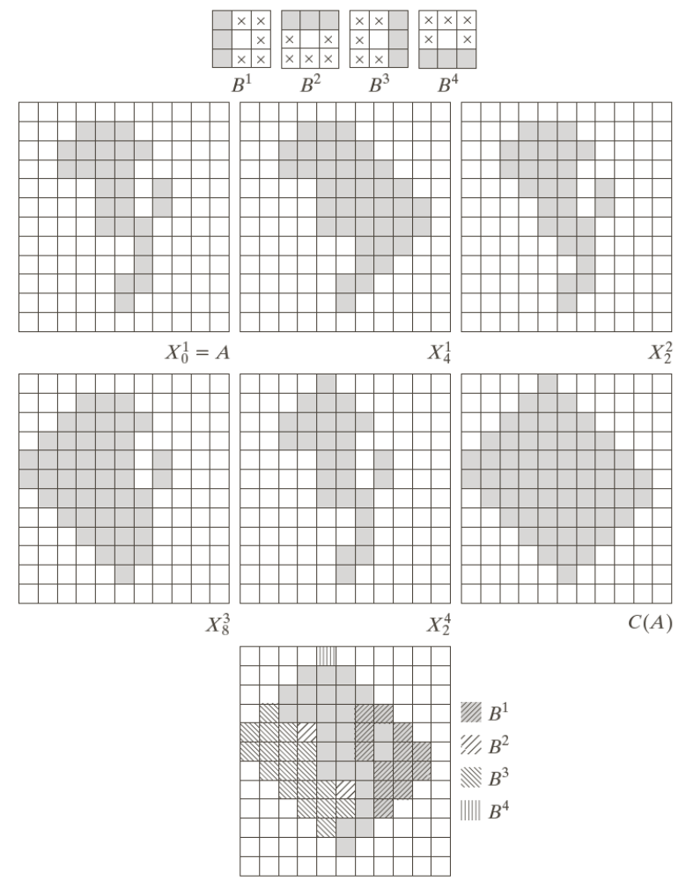
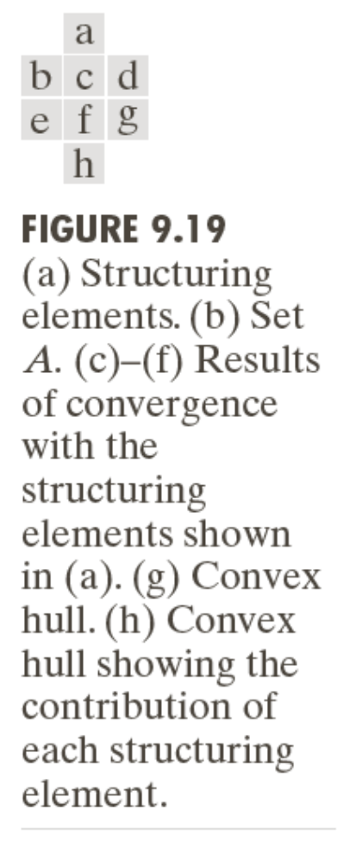


Slide 28
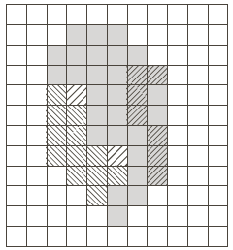
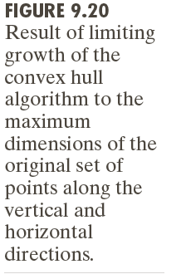

Slide 29
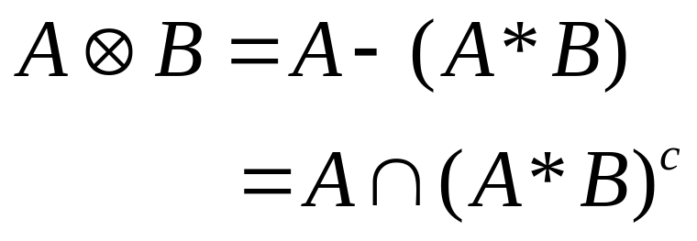
Some Basic Morphological Algorithms (5)
Thinning
The thinning of a set A by a structuring element B, defined

Slide 30
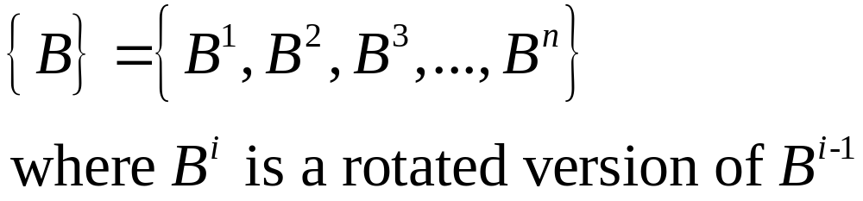
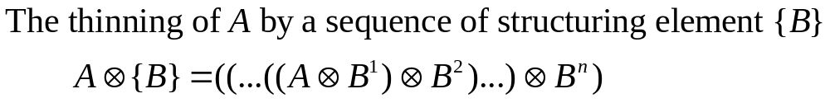
Some Basic Morphological Algorithms (5)
A more useful expression for thinning A symmetrically is based on a sequence of structuring elements:

Slide 31
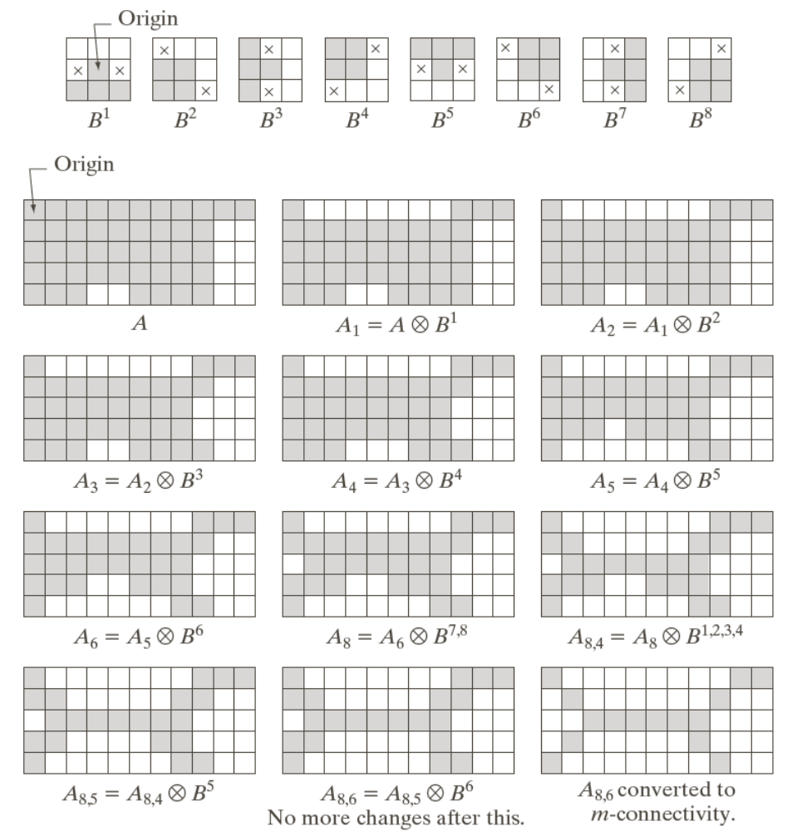
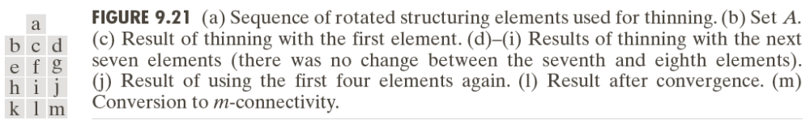

Slide 32
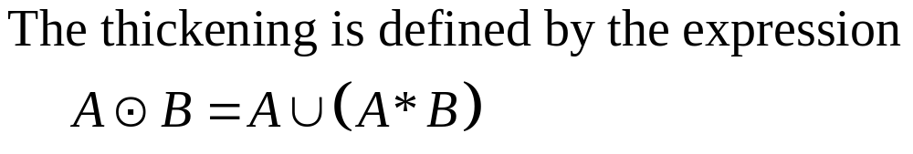
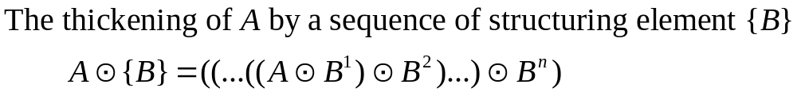

Some Basic Morphological Algorithms (6)
Thickening:

Slide 33
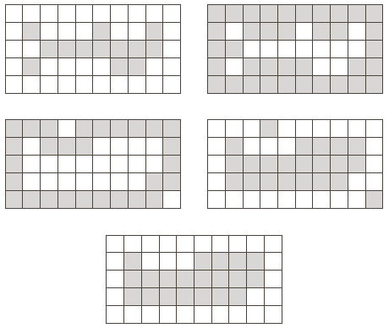


Some Basic Morphological Algorithms (6)

Slide 34
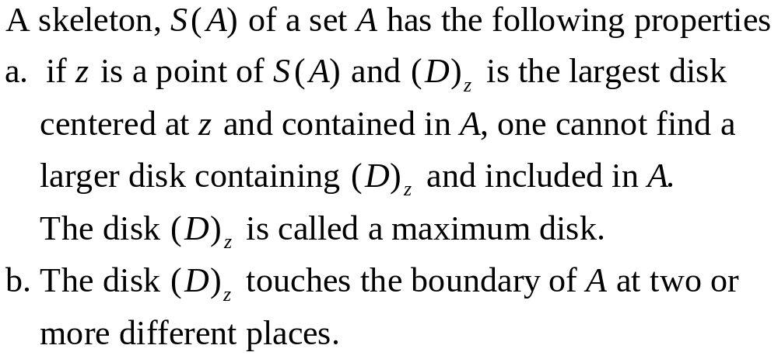
Some Basic Morphological Algorithms (7)
Skeletons

Slide 35
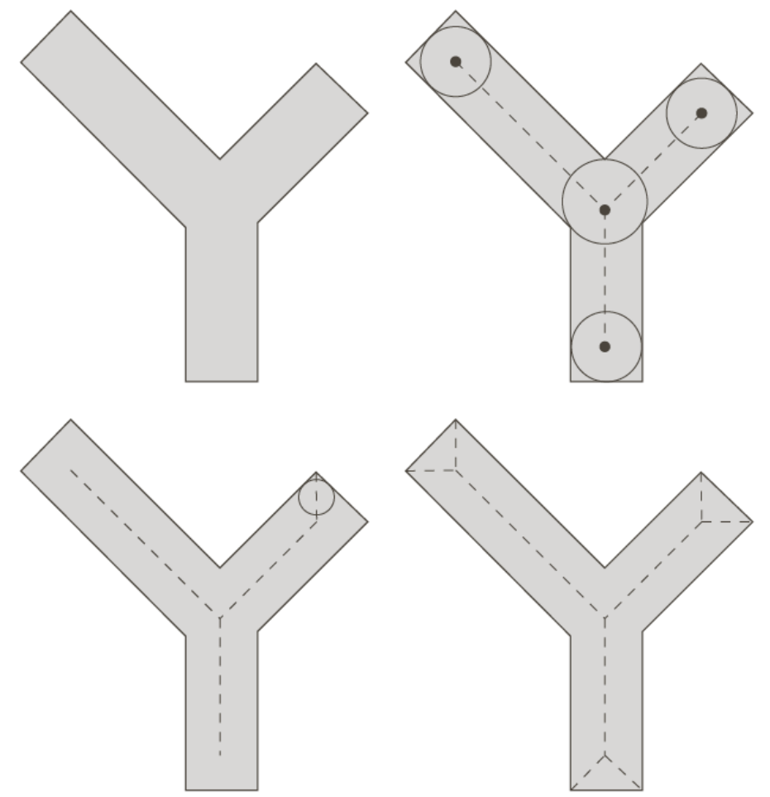
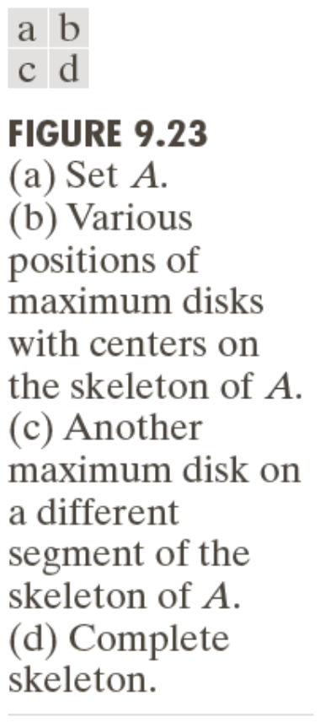
Some Basic Morphological Algorithms (7)

Slide 36
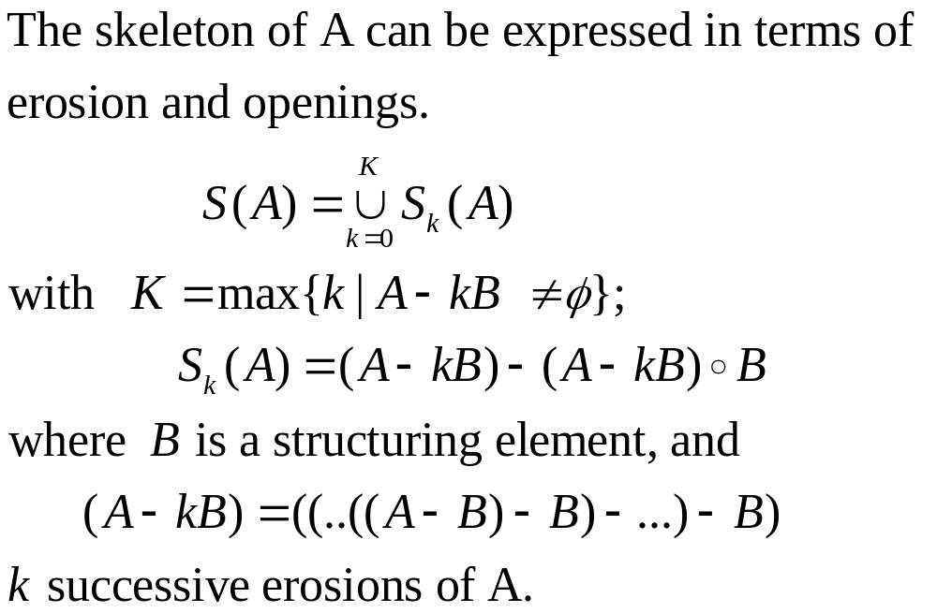
Some Basic Morphological Algorithms (7)

Slide 37
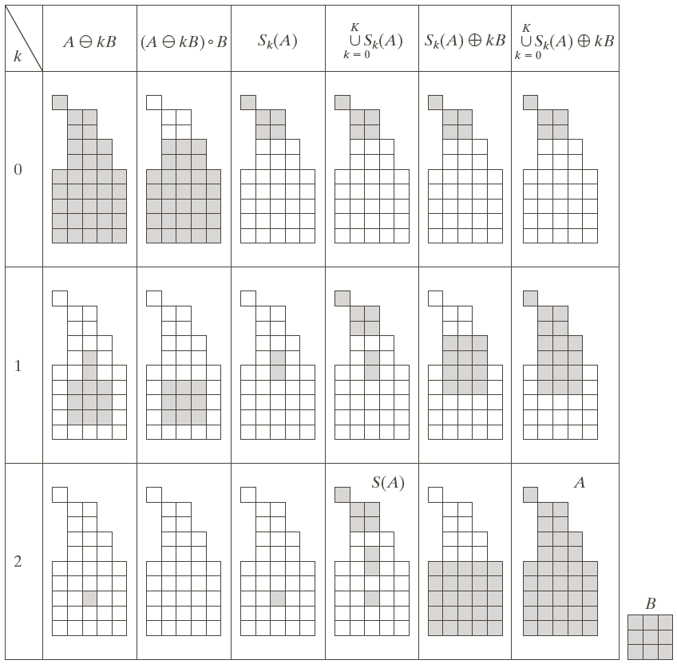
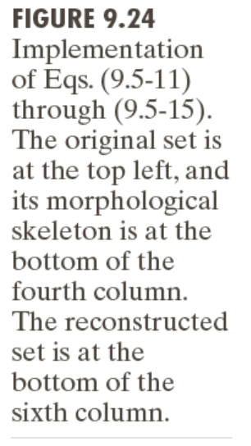

Slide 39
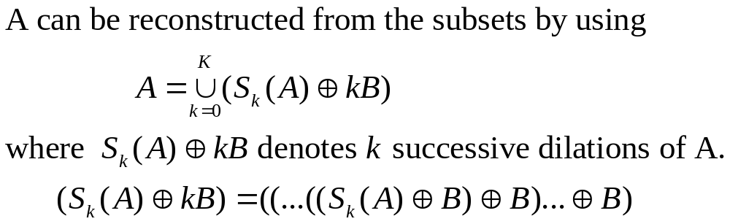
Some Basic Morphological Algorithms (7)

Slide 41

Some Basic Morphological Algorithms (8)
Pruning

Slide 42



Pruning: Example

Slide 43

Pruning: Example

Slide 44

Pruning: Example

Slide 45

Pruning: Example

Slide 46
Pruning: Example

Slide 47

Some Basic Morphological Algorithms (9)
Morphological Reconstruction

Slide 48


Morphological Reconstruction: Geodesic Dilation

Slide 49



Slide 50


Morphological Reconstruction: Geodesic Erosion

Slide 51



Slide 52

Morphological Reconstruction by Dilation

Slide 53



Slide 54

Morphological Reconstruction by Erosion

Slide 55

Opening by Reconstruction

Slide 56

Filling Holes

Slide 57




Slide 58




Slide 59

Border Clearing

Slide 60



